Slide 1
ELS: Data from multiple providers Coordinating the supply Dorus Kruse

Slide 2

Topics
Coordinating the supply
The approach in ELF and Open ELS;
Task 3 in Open ELS: Data supply coordination;
Challenges:
Technical challenges
Governance issues
The devil is in the details
Lessons learned;
Next.

Slide 3

The approach in ELF
Coordinating the supply
Cascading service;
Inspire services as is;
Showcase application only;
Data providers partner of EU funded project;
Focus on WFS’s.

Slide 4





















ELF services summary
Coordinating the supply

Slide 5

The approach in Open ELS
Coordinating the supply
Cascading service;
Data quality checks;
Open Data licence agreement;
No funding for providing data;
Focus on products and data needed for these products.

Slide 6

Task 3 in Open ELS: Data supply coordination and Data quality
Coordinating the supply
Focus on products;
Only accepting validated data;
Need for signed data agreements;
Budget for capacity building.

Slide 7
Cadastral Index Map
Coordinating the supply
Ready and DPA signed
Some minor issues or DPA
Not open data
Prospect

Slide 8
Addresses
Coordinating the supply
Ready and DPA signed
Some minor issues or DPA
Not open data
Prospect
Malta

Slide 9
Buildings
Coordinating the supply
Ready and DPA signed
Some minor issues or DPA
Not open data
Prospect
Malta

Slide 10
Transport Network - Road
Coordinating the supply
Ready and DPA signed
Some minor issues or DPA
Not open data
Prospect
Malta

Slide 11
Transport Network - Rail
Coordinating the supply
Ready and DPA signed
Some minor issues or DPA
Not open data
Prospect
Malta

Slide 12

Challenges
Coordinating the supply
Technical challenges:
ETF validation;
Capacity building;
Signed agreements;
Difficult WFS specs.
Governance issues:
No funding for providing data;
No real users or first adopters ready;
National priorities;
Architecture depending on national services and performance.
Organisational challenges:
EU Grant Agreement versus Agile development;
no sale = no data;
Partner agreement regarding deliverables, not on data.

Slide 13
Engagement status by coverage
Coordinating the supply
In hands / testing
Contact later
No open data
Interest, but not priority
Expected response
Malta

Slide 14

Lessons learned
Coordinating the supply
Change architecture;
Funding needed for providing data;
Agile development (involvement users);
WFS 3.0;
Compliancy with MQA, metadata DCAT-AP, multilingual;
User orientation and user requirements;
Coalition / community of the willing.

Slide 15
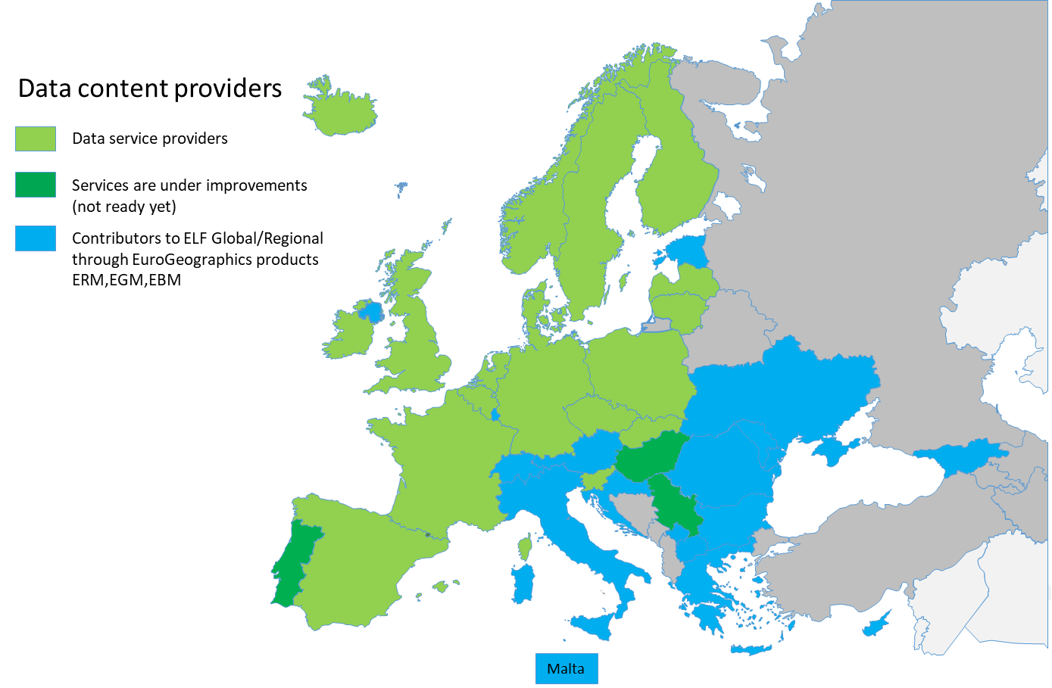
The potential coverage of Data providers in ELS
Coordinating the supply

Slide 16

Next
Coordinating the supply
WFS 3.0 !!
Centralised system.
Privacy and security means Authoritative data.
Coalition of the willing !!

